Slide 1
Troubleshooting PTL walls

Slide 2
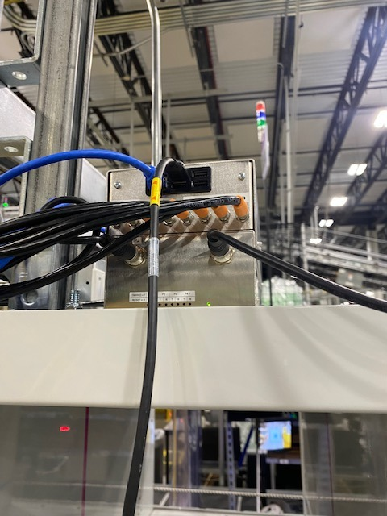
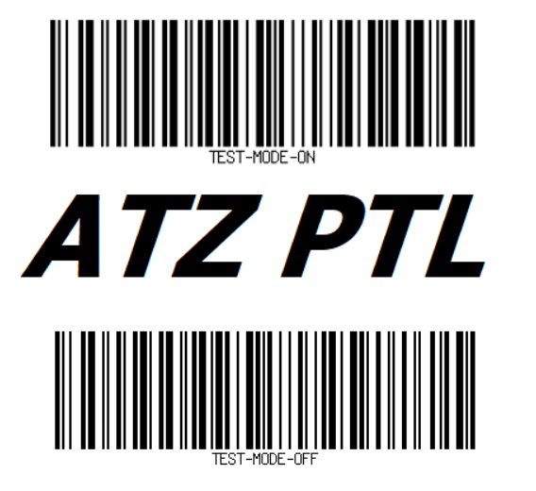
PLUG THE HAND SCANNER INTO THE PI-CON
The Pi-Con is located at the top of each wall (top left if looking at the black light bars, top right if looking at the grey).
Plug the USB hand scanner into the Pi-Con and wait for it to boot up
Scan the “Test Mode On” barcode below to enter test mode

Slide 3


Test Barcode not working?? Try this with the hand scanner !
FACTORY SETTINGS
**Plug the hand scanner into your computer**
Once the scanner is plugged into your computer, Scan the factory setting barcode. This resets the hand scanner. Wait a few seconds before proceeding to the next step
AMZN SETTINGS
Scan the second barcode to load Amazon settings into the hand scanner
Go back to the first slide to connect to the Pi-Con and try out the Test Mode barcode

Slide 4
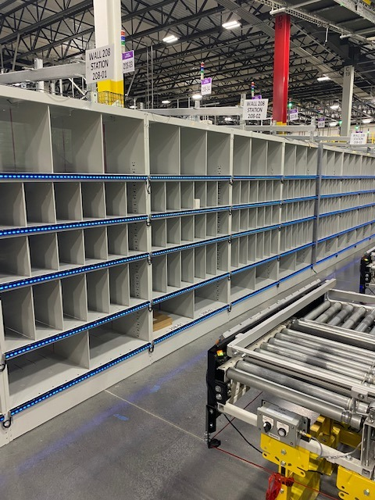
TROUBLESHOOTING WALL ISSUES IN TEST MODE
Test mode will turn all of the light bars blue.
While in test mode, if you touch a sensor it will turn the light green which indicates the sensor is working.
All of these bars are wired in series, meaning if a problem exists on one light bar, it will effect everything that is wired in after it. There are 2 conditions that will notify you of a problem: 1. When you touch a sensor and it does not change the light to green
2. No blue lights on a portion of the wall
Continue to next slide for examples

Slide 5
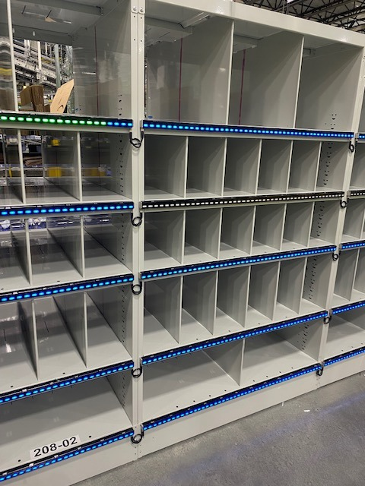
TROUBLESHOOTING WALL ISSUES IN TEST MODE
When you touch a sensor and it does not turn the light green. If one sensor goes out, the rest down that line go out as well. Inspect the cables/faceplate for any damage to find your problem. Once that specific location is fixed, the rest of the wall will work again.
No blue lights on a portion of the wall. Wherever the lights stop, that is where the issue is. It could be the black cable that connects the light bars is faulty, the ribbon cables within the light bars, or the face plate of the light bar its self. Once the issue is resolved at that specific location, the rest of the wall will start to work

Slide 6
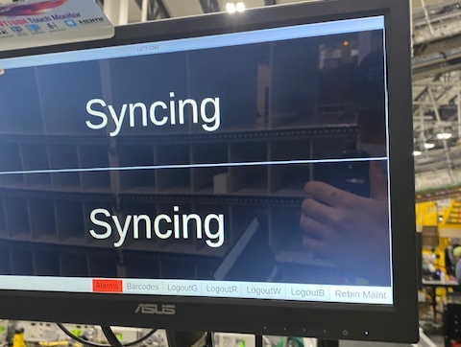
GETTING OUT OF TEST MODE
When you are finished troubleshooting, you have to exit Test Mode.
Scan the barcode on this page while still plugged into the Pi-Con and it will turn all of the lights off.
Next, press the “Rebin Maint” Button on any of the touch screens at the rebin stations. This will re-sync everything and you will be good to go ! When replacing parts on this wall, no programming is necessary. Everything is plug and play (except for the Pi-Con units themselves)

Slide 7
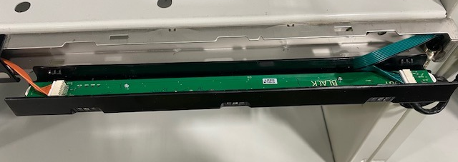
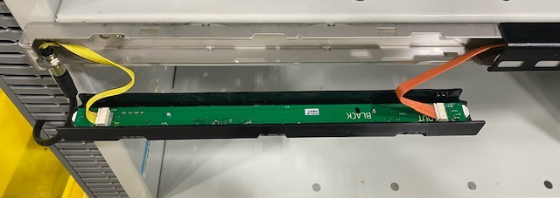
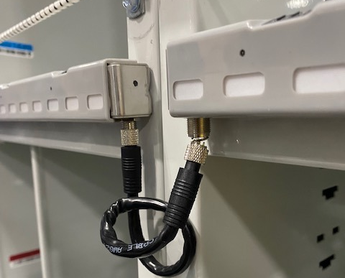
COMMON BROKEN/DAMAGED PARTS

Slide 8
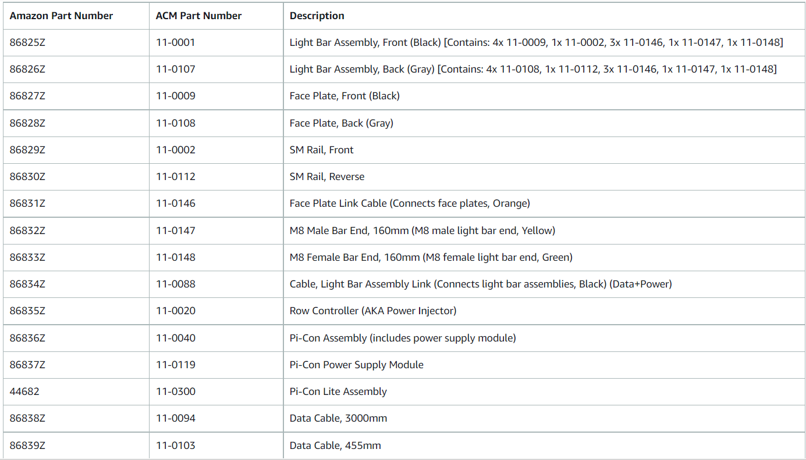
PART NUMBERS

Slide 9
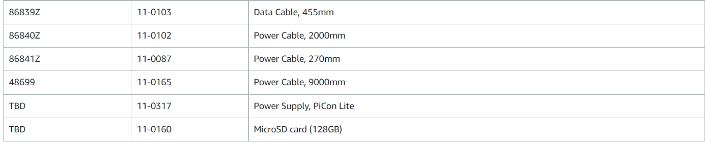
PART NUMBERS CONTINUED

